Slide 1
Dissolvable Data
Andy Oh Sean Slavin Baskaran Viswanathan

Slide 2
Quick Facts
USELESS
3 Brains
11 Days
28 hours of brainpower
3 MacBooks
0 Energy Drink
# of Hours Worked on Project
Date | Day | Baskaran | Sean | Andy
9/19 | Tuesday | 3 | 3 | 3
9/20 | Wednesday | 1 | 0 | 1
9/21 | Thursday | 3 | 4 | 3
9/22 | Friday | 0 | 0 | 1
9/23 | Saturday | 4 | 5 | 4
9/24 | Sunday | 2 | 0 | 0
9/25 | Monday | 0 | 2 | 1
9/26 | Tuesday | 4 | 3 | 3
9/27 | Wednesday | 1 | 2 | 1
9/28 | Thursday | 4 | 3 | 3
9/29 | Friday | 4 | 6 | 6
11 Days |  | 26 | 28 | 26

Slide 4
Collaboration Tools

Slide 5
Where to set up a company?

Slide 6
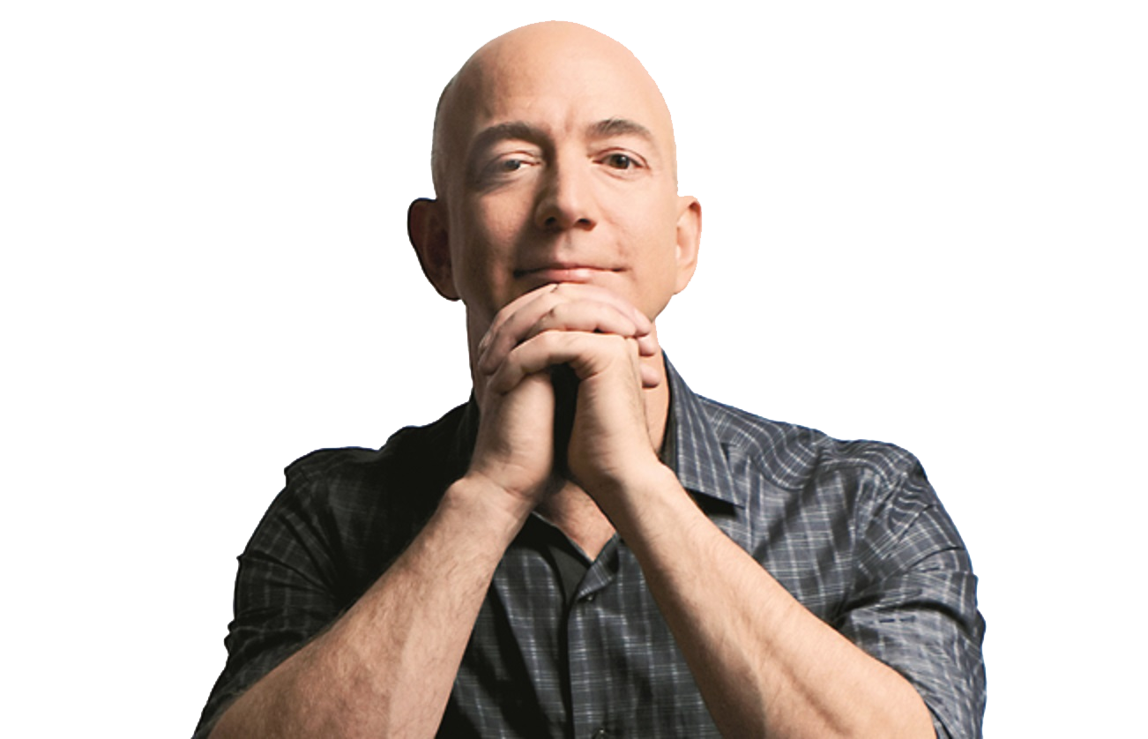
Jeff Bezos
Amazon HQ2
Population ≥ 1,000,000
Major Airport ≤ 45 minutes
City Center ≤ 30 miles
50,000 workers

Slide 7
textio
MarketWatch

Slide 8
Quartz
Brookings Institution

Slide 9
Data Source
U.S. Census Bureau
https://www.census.gov/data.html
U.S. Bureau of Labor Statistics
https://www.bls.gov/data/#api
OurAirports
http://ourairports.com/data/
Google Map API – Distance Matrix
https://developers.google.com/maps/documentation/distance-matrix/

Slide 10
Process
Census Data
Labor Force Data
Airport Data
Distance Matrix

Slide 11
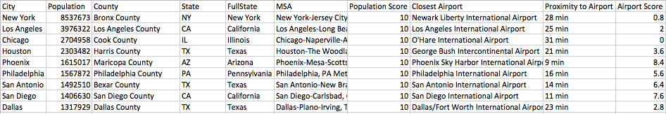
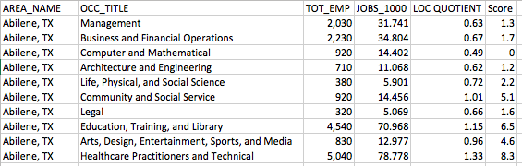
Raw Data
Census Data
Labor Force Data

Slide 14
Code

Slide 15
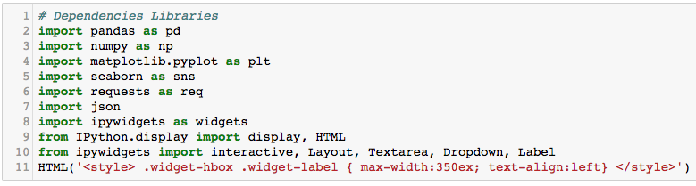

Slide 16
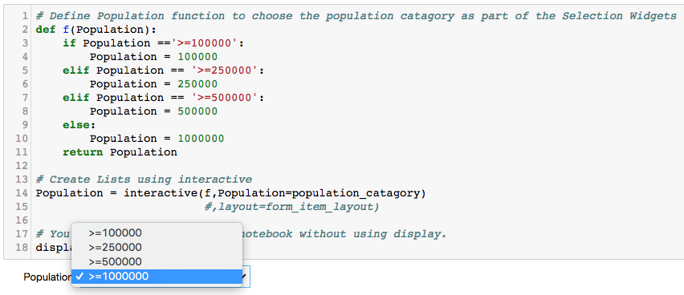

Slide 17
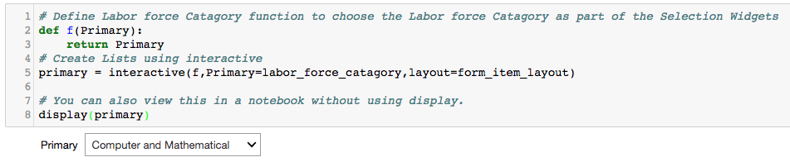

Slide 18
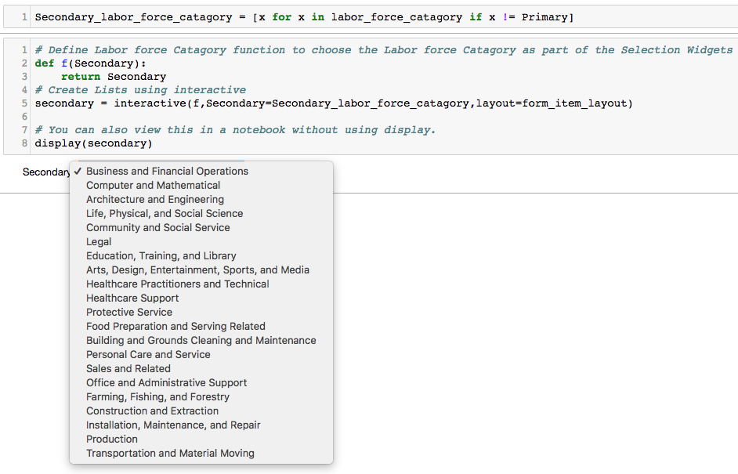

Slide 19
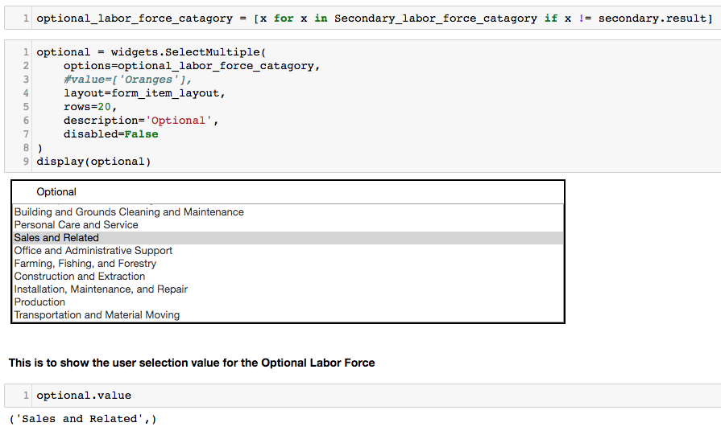

Slide 20
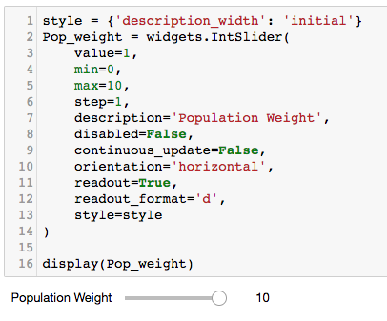
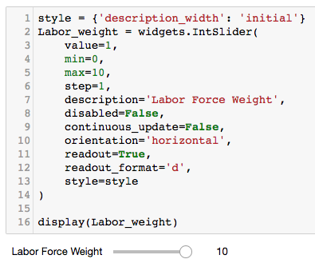

Slide 21
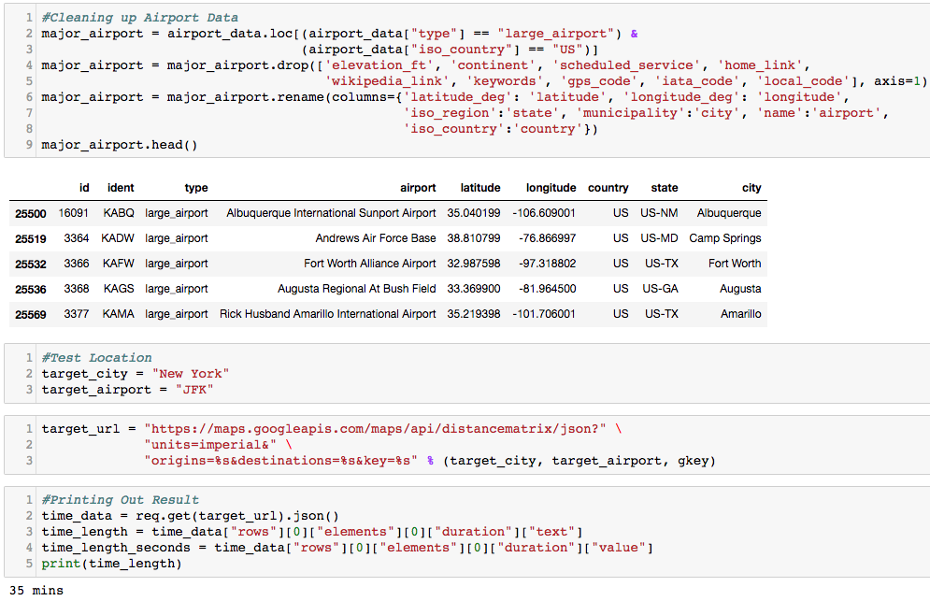

Slide 22
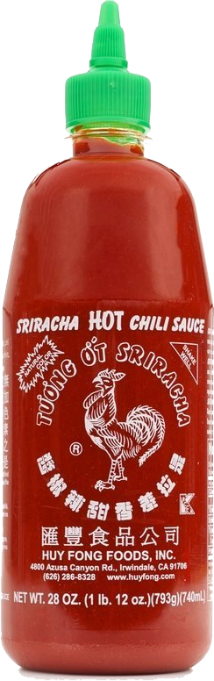
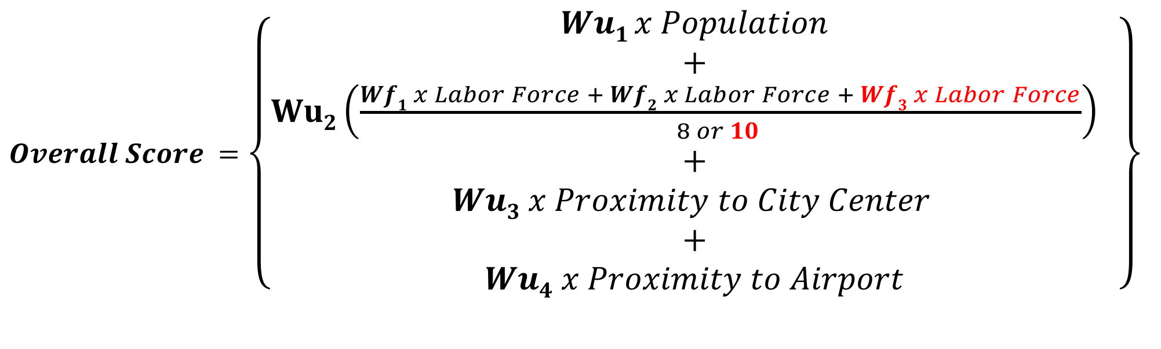
The Secret Sauce
$Overall Score =$ $\left\{\begin{aligned}Wu1 x Population \\ + \\ Wu2\left(\frac{Wf1 x Labor Force + Wf2 x Labor Force + Wf3 x Labor Force}{8 or 10 }\right) \\ + \\ Wu3 x Proximity to City Center \\ + \\ Wu4 x Proximity to Airport\end{aligned}\right\}$
Wu_{1…4} and Wf_{1…3} are weighted values

Slide 23
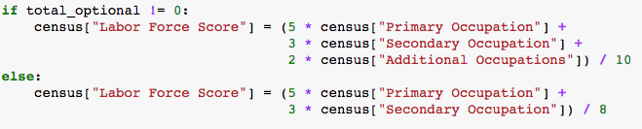
Secret Sauce in Code

Slide 24
Result – Amazon HQ2

Slide 25
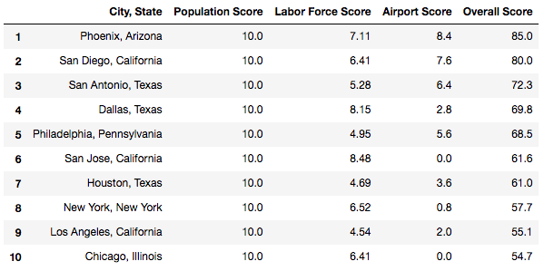

Slide 26

Result Comparisons
Dissolvable Data
# | City
1 | Phoenix
2 | San Diego
3 | San Antonio
4 | Dallas
5 | Philadelphia
Bloomberg
# | City
1 | Toronto
2 | Boston
3 | Washington
4 | Atlanta
5 | Dallas
Quartz
# | City
1 | Salt Lake City
2 | Denver
3 | Boston
4 | Raleigh
5 | Washington DC
MarketWatch
# | City
 | Atlanta
 | Austin
 | Baltimore
 | Boston
 | Bridgeport
CityLab
# | City
1 | Chicago
2 | Dallas
3 | Philadelphia
4 | Atlanta
5 | Phoenix
Textio
# | City
1 | Birmingham
2 | Grand Rapids
3 | Montreal
4 | Salt Lake City
5 | New Orleans

Slide 27
Not bad, right?

Slide 28
Dissolvable Data Company

Slide 30
Wish List
Accuracy would be greatly improved if we use:
Commercial Real Estate Data
Mass Transit Data
Community Fit/Cultural Diversity Data

Slide 31
Challenge

Slide 32
Questions? Comments?

